Slide 1
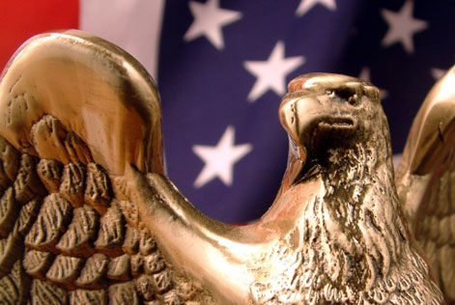
“Political Parties”

Slide 2
What are Political Parties?
A political party is a group of citizens (voters) with similar views on public issues who work to put their ideas into effect through government action and who band together to elect candidates.
Political parties seek to win elections and hold public office.

Slide 3
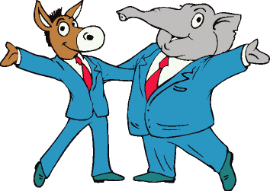
Purpose of Political Parties
Parties pick candidates who agree with their beliefs and try to persuade voters to support their candidates who are running for office. Political parties also:
Inform and activate their supporters
Act as “bonding agents” to ensure that their candidates perform well in office
Utilize partisanship to govern – push the ideas of their party through the government.
Act as a watchdog to ensure that all members of the government are having properly and enforcing policies correctly.

Slide 4
Political Spectrum
The United States today has a two-party system, which means that we have two main political parties.
Generally, parties are often labeled as “liberal” or “conservative,” depending on their views.
Parties fall somewhere on the political spectrum (a range referring to differences in political views).
Most people fall somewhere in the middle and are known as “moderates.” They generally lean toward one side or the other.
Left Moderate Right
“Liberal”
“Conservative”

Slide 5
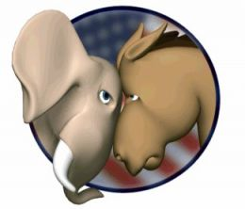
Today’s Major Parties
A basic difference between the major parties is their belief in how much the government should be involved in the lives of Americans.
We call this their political ideologies – the way they feel on certain issues.

Slide 6
Crash Course – Political Ideologies

Slide 7
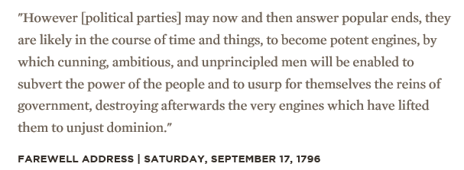
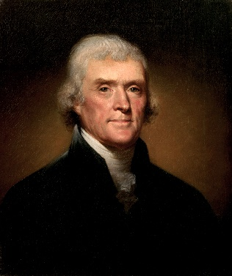
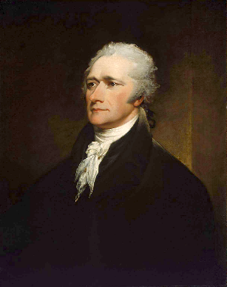
American History – The Two Party System
Washington warned against the evils of political parties in his Farewell Address
Historians believe that political parties can be traced back to the writing of the Constitution when the Federalists and Anti-Federalists formed.
The first full-blown political parties were the Federalist Party (Alexander Hamilton) and the Democratic-Republican Party (Thomas Jefferson). These two men had very different ideas about the type of influence that government should have on the lives of Americans.
The origins of today’s major political parties can trace their roots back to these two parties.

Slide 8
American History – The Two Party System

Slide 9
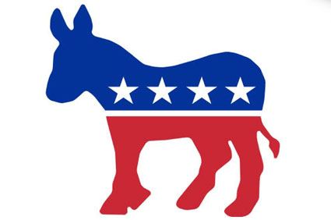
Today’s Major Political Parties
Democrats are generally said to be more liberal.
They favor more government programs that offer services in housing, education, healthcare, and economics.
These programs would be funded through taxes.

Slide 10
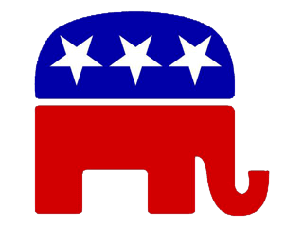
Today’s Major Parties
Republicans are generally said to be more conservative.
Republicans tend to believe that they can help the nation’s economy grow by reducing the amount of taxes that people have to pay.
They favor less government regulation of the economy.
They are opposed to raising taxes.

Slide 11
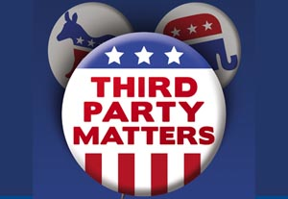
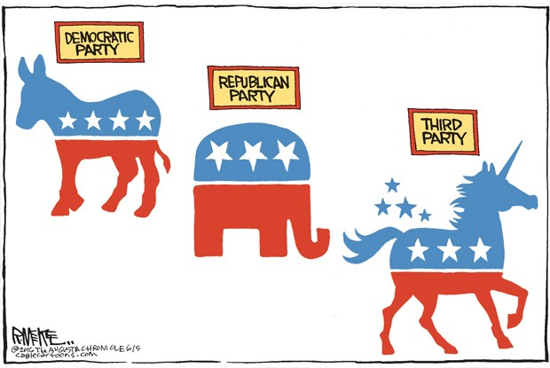
Third Parties
Although they sometimes challenge the two major parties, a Third Party has never won a Presidential election and has rarely won any other major elections.
This is because they are usually very focused on specific issues. There are different types of third parties:
Ideological Parties – focused on a core belief system (Communist, Socialist Labor Parties)
Single-issues Parties – focused on one public policy matter. (Prohibition Party)
Economic Protest Parties – express their discontent with current economic times (Greenback Party, Populist Party)
Splinter Parties – a faction of a major political party that breaks away and forms its own (Bull-Moose Progressive Party)

Slide 12
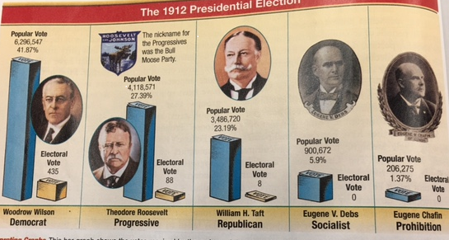
Third Parties
Third Parties, however, can affect the outcome of elections and may also influence government policy.

Slide 13
Third Parties
Third Parties rarely win major elections because of the two-party tradition.
For example, while the names of Republican and Democratic candidates are automatically placed on the ballot, Third-Party candidates must obtain a large number of signatures to get on the ballot.

Slide 14
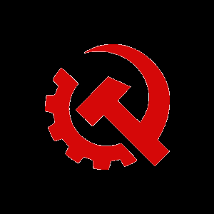
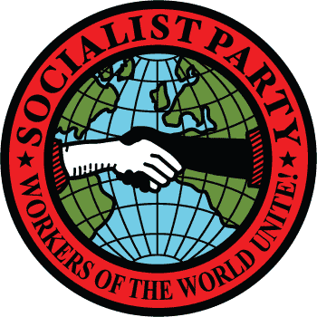
Modern Examples of Third Parties
The Communist Party supports the rights of the workers and economic equality.
The Socialist Party supports government ownership/allocation of resources.
The Libertarian Party would like to increase individual freedoms by cutting the size of the U.S. government.
According to the Libertarian party, they are “more liberal than Democrats, yet more conservative than Republicans.”
There is also the Green Party, Natural Law Party, the Prohibition Party, and a bunch of others.

Slide 15
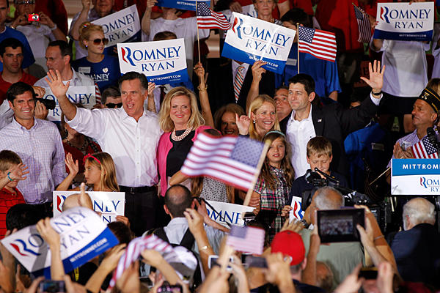
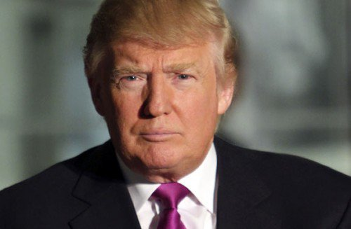
Party Platforms
To know where a party stands on the major issues, voters can look at the party’s platform.

Slide 16
Party Platforms
A platform is a series of statements expressing the party’s principles, beliefs, and positions on issues.
Each individual part of a platform is called a plank.

Slide 17
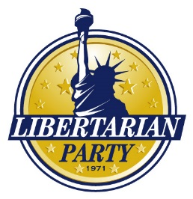
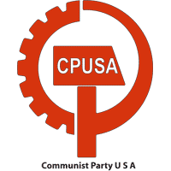
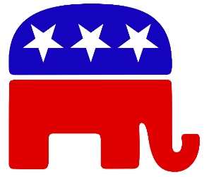
Where do they stand on the Economy, Heath Care, Environment, Education???

Slide 18
The Issues – Federal
 | Platform (Overall Party Concerns) | Democratic Party Platform | Republican Party Platform
Plank 1 (Specific Issue) | Unites States Economy | Wants the federal government to place regulations on businesses to influence economic growth | Wants to use tax relief to grow economy and create jobs
Plank 2 (Specific Issue) | Education | Wants to raise standards in K-12 Schools and increase financial aid for secondary education | Wants to increase access to charter schools, and promote accountability for students and parents
Plank 3 (Specific Issue) | Health Care | Mandated healthcare for all citizens | Says mandated healthcare is unconstitutional. Supports Medicare
Plank 4 (Specific Issue) | Energy | Supports industry of creating green energy | Wants America to resume off-shore drilling to boost economy and lower energy costs

